Slide 1

E-Commerce Inventory Management System!

Slide 2

Project Overview and Objectives
objective
This project is designed for a multi-user platform where Admins, Sellers, and Buyers interact with the system. The system is implemented in C++ using unordered maps for efficient storage and retrieval of data, along with stacks to manage seller communication messages.
Goal
The goal of this project is to create an E-Commerce Inventory Management System that efficiently manages stores, products, and user interactions using unordered maps and stacks in C++. It aims to showcase real-world applications of data structures in a user-friendly, multi-user platform.

Slide 3




Key Features and Functionalities
Admin Functions
Seller Functions
Add, view, and delete stores with detailed information.
Register and log in to stores securely.
Send messages to sellers using a stack for LIFO-based message retrieval.
Manage inventory by adding, updating, or deleting products.
View sales performance and total earnings.
Access messages from admins stored in a stack..
Buyer Functions
Core Features
Register, log in, and manage account details.
Unordered Maps: Fast and efficient storage and retrieval of buyer and store data using CNIC as a key.
Browse and purchase products from available stores.
Check account balance and account details CNIC , Name.
Stacks: Effective handling of admin-to-seller communication for prioritized message delivery.
Can update account balance if their balance below 50$.
Used 3 Files Structure HeaderFile.h

Slide 4
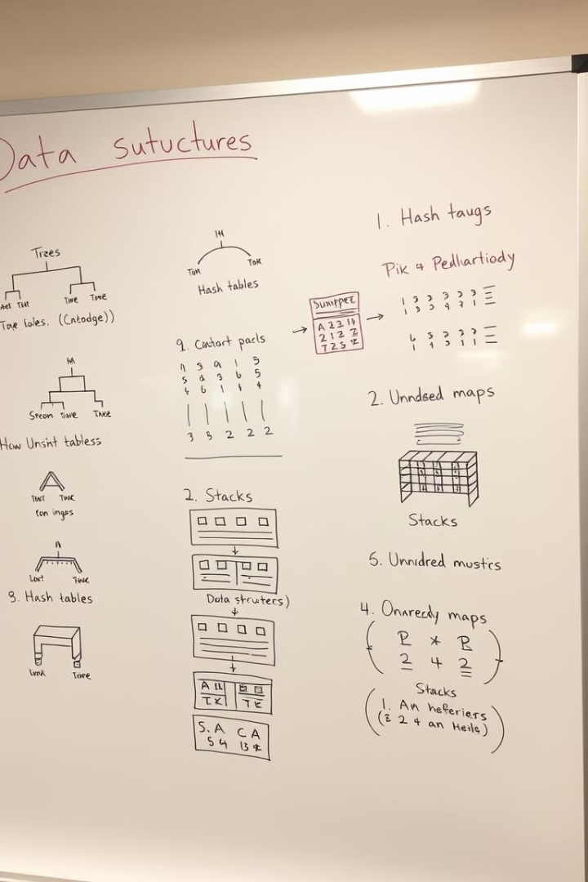
Data Structures Utilized
1
Hash Tables / unordered_map / map
Efficiently searching and retrieving product data based on product IDs.
2
Stack
Admin Sending Messages to different stores efficiently most important appear first.

Slide 5

Time Complexity Analysis
1
Adding, Removing Stores Products
Hash tables offer efficient deletion with O(1) average time complexity.
2
Updating Deleting Stores Products
Hash tables offer efficient updating and deletion with O(1) average time complexity.
3
Searching Products Stores
Hash tables offer efficient searching with O(1) average time complexity.
4
Push and Display Messages using Stack
Stack has time complexity of O(1) for insertion deletion.

Slide 6






System Architecture and Integration
Admin Module
Seller Module
Buyer Module
Handles store registration, deletion, and viewing.
Provides features for store registration, inventory management, and sales tracking.
Manages buyer registration, login, and account features.
Manages communication with sellers via a stack for storing and retrieving messages in LIFO order.
Interacts with the stack to read admin messages and responds accordingly.
Enables product browsing, purchasing, and store rating.
Data Management
Integration
3 File Structure Approach
Unordered Maps: Centralized storage for buyers and stores, ensuring fast data retrieval using CNIC as a unique key.
The modules are interconnected via shared data structures, ensuring smooth interaction between users.
I have used a 3 files structure approach to divide my code in separate files for easy reading and understanding.

Slide 7

Any Questions?
Thank you for your time. I'm happy to answer any questions you might have.

